Slide 1
Collecting Data
11.3

Slide 3
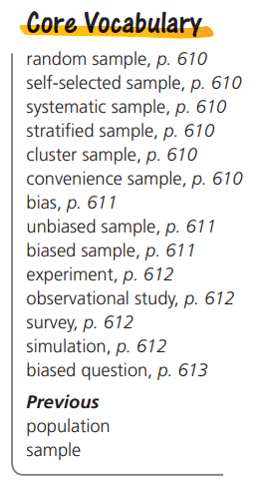
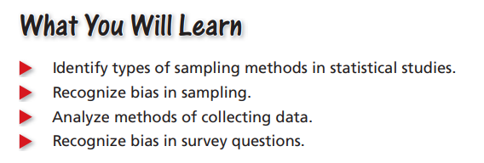

Slide 4
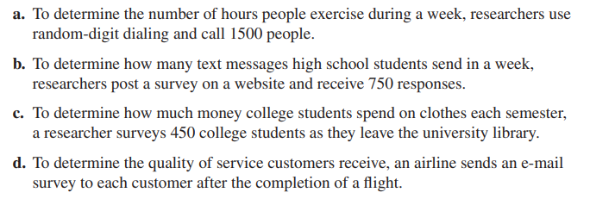
Analyzing Sampling Techniques
Determine whether each sample is representative of the population.. Explain your reasoning.

Slide 5
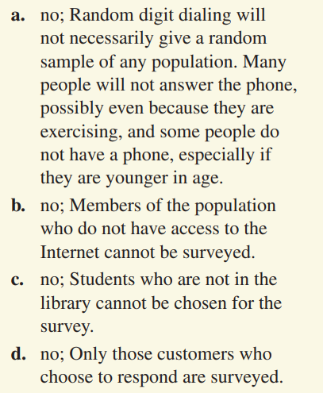

Slide 6
Analyzing Survey Questions
Determine whether each survey question is biased. Explain your reasoning. If so, suggest an unbiased rewording of the question.

Slide 7
yes; It encourages a yes response; Sample answer: What effect does eating whole-grain food have on health?
yes; It encourages a no response; Sample answer: Do you ever text while driving?
no; It is a simple question to which an accurate response can be given.
d. yes; It implies the mayor needs to improve his or her public image; Sample answer: How would you describe the mayor’s public image?

Slide 8
Analyzing Survey Randomness and Truthfulness
Discuss each potential problem in obtaining a random survey of a population. Include suggestions for overcoming the problem
The people selected might not be a random sample of the population.
b. The people selected might not be willing to participate in the survey.
c. The people selected might not be truthful when answering the question.
d. The people selected might not understand the survey question.

Slide 9
Sample answer: It is possible to select a group that would not be representative of the population as a whole; Choose a random sample.
Sample answer: The people choosing not to respond may represent a response different from those choosing to respond; Offer some type of reward to encourage participation
Sample answer: The results would not be representative of the true opinions of the population; Provide a method of completing the survey anonymously.
Sample answer: The people selected may not respond in a way that represents their true opinion; Rewrite the survey question so it is clear.

Slide 11
There are many different ways of sampling a population, but a random sample is preferred because it is most likely to be representative of a population. In a random sample, each combination of members of a given sample size, n, of a population has an equal chance of being selected.
What are some ways of random sampling?
Number everyone in the population and use a random number generator
Picking names out of a hat

Slide 12
Ways to select a sample
PICK FROM THE FULL POPULATION
Self-selected
Members choose/volunteer to participate
Example: online survey
Systematic
Use a rule/process to select members
Example: select every other person
BREAK POPULATION INTO GROUPS, PICK FROM GROUPS
Convenience
Pick members that are easy to reach
Example: select all my neighbors
Stratified
Pick key attributes, group by those attributes
Groups are different from each other, each with different attribute
Individuals w/in each group are similar/have same attribute
Example: group by gender
Cluster
Divide population into groups, each group represents the population
Each group is similar, looks like the others … groups are homogeneous
Individuals w/in each group are different, have different attributes
Example: group by street from a larger community,

Slide 13
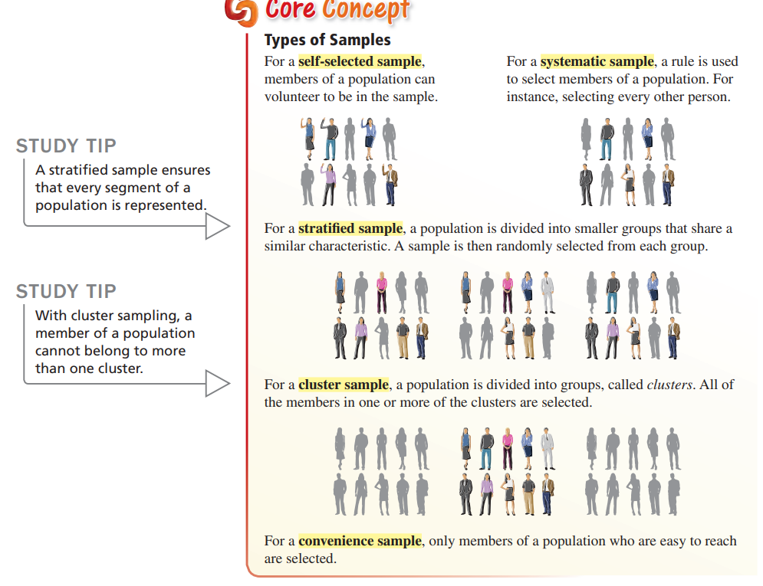

Slide 14
HOW DOES STRATIFIED DIFFER FROM CLUSTER SAMPLING?
Stratified Sample:
Population broken into groups
Groups are different from each other
Groups are diverse
Individual member of a group are all the same in some sense
Individuals are homogeneous
Cluster Sample:
Population broken into groups
Groups all have the same make-up, are similar/same
Groups are homogeneous
Individual members of a group are diverse
Individuals are diverse
 | Groups | Individuals
Stratified | Different from each other | Homogeneous
Cluster | Homogeneous | Different from each other

Slide 15
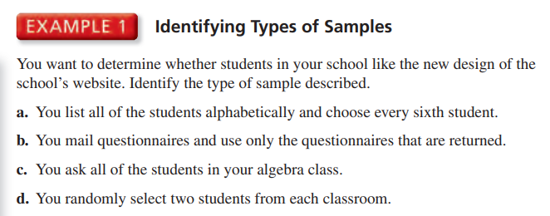
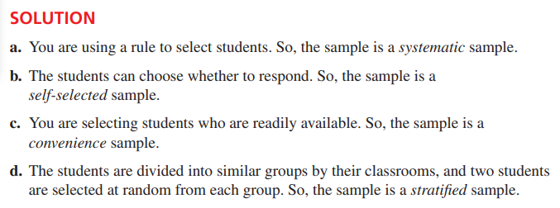
, each a diff subject

Slide 16
Recognizing Bias in Sampling
A bias is an error that results in a misrepresentation of a population.
In order to obtain reliable information and draw accurate conclusions about a population, it is important to select an unbiased sample. An unbiased sample is representative of the population that you want information about.
A sample that over-represents or under-represents part of the population is a biased sample. When a sample is biased, the data are invalid.
A random sample can help reduce the possibility of a biased sample.

Slide 17
Identifying Bias in Samples
Identify the type of sample and explain why the sample is biased.
A news organization asks its viewers to participate in an online poll about bullying.
A computer science teacher wants to know how students at a school most often access the Internet. The teacher asks students in one of the computer science classes.
SOLUTION
The viewers can choose whether to participate in the poll. So, the sample is a self-selected sample. The sample is biased because people who go online and respond to the poll most likely have a strong opinion on the subject of bullying.
SOLUTION
The teacher selects students who are readily available. So, the sample is a convenience sample. The sample is biased because other students in the school do not have an opportunity to be chosen.

Slide 18
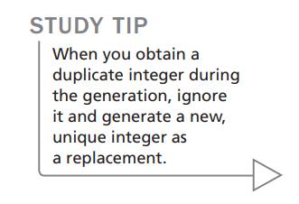
Selecting an Unbiased Sample
You are a member of your school’s yearbook committee. You want to poll members of the senior class to find out what the theme of the yearbook should be. There are 246 students in the senior class. Describe a method for selecting a random sample of 50 seniors to poll.
ONE POSSIBLE SOLUTION
Step 1 Make a list of all 246 seniors. Assign each senior a different integer from 1 to 246.
Step 2 Generate 50 unique random integers from 1 to 246 using the randInt feature of a graphing calculator.
Step 3 Choose the 50 students who correspond to the 50 integers you generated in Step 2.

Slide 19
The manager of a concert hall wants to know how often people in the community attend concerts. The manager asks 45 people standing in line for a rock concert how many concerts they attend per year. Identify the type of sample the manager is using and explain why the sample is biased.
SOLUTION:
convenience sample; People in the community who do not attend rock concerts do not have an opportunity to be chosen

Slide 20
Homework Textbook page 614; Exercises 5 – 12, 14 - 19

